Slide 1


Digital Marketing
Project : 1 Crafting compelling Web presence
BY:
Divyaraj Murugan
MBE4

Slide 2


INTRODUCTION
Welcome to the presentation on Crafting Compelling Web Presences.
Today, we'll delve into the foundational principles of digital marketing and explore strategies to design and build impactful websites.

Slide 3

The Foundation of Digital Marketing
First Impressions Matter: Establish trust and credibility with a visually appealing and user-friendly website.
24/7 Accessibility: Provide round-the-clock access to your products or services, catering to global audiences.
Central Hub for Information: Offer comprehensive details about your offerings, empowering customers to make informed decisions.
Enhanced Visibility: Optimize your website for search engines to improve visibility and attract organic traffic.
Effective Marketing Tool: Utilize your website as a powerful platform for showcasing products/services and running marketing campaigns.

Slide 4

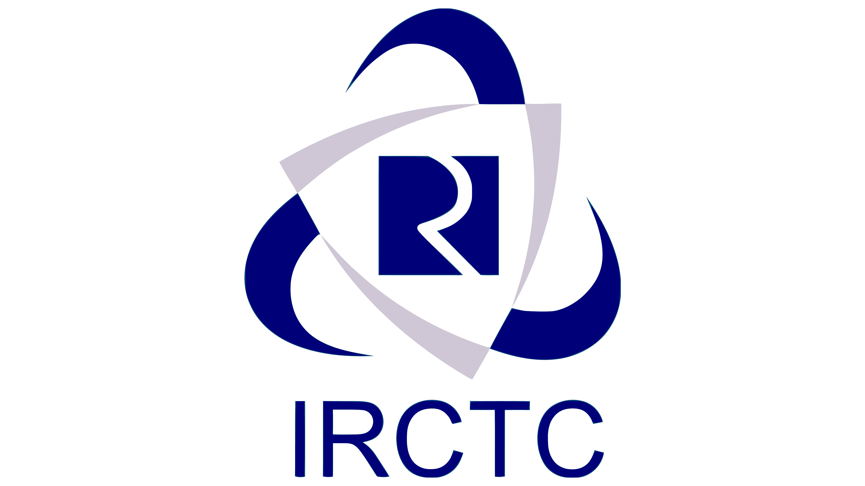

Company Selection
Titan Watches
Indian Bank
IRCTC (Indian Railway Catering and Tourism Corporation)

Slide 5
ABOUT COMPANY
Company: Titan Watches
Luxury timepieces blending style and precision for discerning individuals.
Company: Indian Bank
Comprehensive banking solutions including savings accounts, loans, and investments.
Company: IRCTC
Online booking services for train tickets, tours, and packages, catering to millions of travelers.

Slide 6
Platform Identifications
Titan Watches: The website of Titan Watches is hosted on the Cloudflare platform, leveraging its robust infrastructure and security features to ensure reliable performance and protection against cyber threats.
Indian Bank: Indian Bank's website is built using PHP and MySQL, two widely-used technologies in web development known for their versatility and scalability, enabling the bank to deliver seamless online banking experiences to its customers.
IRCTC (Indian Railway Catering and Tourism Corporation): IRCTC's website is a Progressive Web App (PWA) developed using Webpack, offering users a fast, engaging, and app-like experience on the web. This modern approach to website development ensures accessibility across various devices and network conditions, catering to the diverse needs of travelers.

Slide 7
Identified Mistakes:
Slow Loading Times: Analysis revealed that all evaluated websites suffer from slow loading times, potentially leading to user frustration and increased bounce rates. This issue may arise from bloated code, large image files, or inefficient server configurations.
Payment Processing Issues: Several instances of payment processing issues were observed across the evaluated websites, including transaction failures, slow checkout processes, and lack of payment method options. These issues can deter customers from completing purchases and undermine the credibility of the websites.
Inefficient User Interface and Experience: Usability issues such as complex navigation menus, cluttered layouts, and inconsistent design elements were prevalent across the websites. These shortcomings detract from the overall user experience, making it challenging for visitors to find relevant information and accomplish their goals efficiently.

Slide 8
Landing Page Design
Titan Watches: Click here to load Titan Landing page
Indian Bank: Click here for India bank landing page
IRCTC: Click here for IRCTC landing page

Slide 9
conclusion
In conclusion, this project has highlighted key principles in digital marketing and website design.
By addressing common mistakes and implementing best practices, we can create impactful web presences that engage users and drive business success.
Let's apply these insights to elevate our online platforms and achieve our marketing goals.
Thank you for your attention and dedication throughout this presentation.

